Slide 1


<Nguyễn Anh Đức>
<04/08/2022>

Slide 2

Outline
Executive Summary
Introduction
Methodology
Results
Conclusion
Appendix

Slide 3
Executive Summary
Summary of methodologies:
Data collection using web scraping and SpaceX APIs
Exploratory Data Analysis (EDA), including data wrangling, data visualization, and interactive visual analytics
Machine learning
Summary of all results:
Collect valuable data from public resource
EDA allowed to identify which features are the best to predict success of launchings;
• Machine Learning Prediction showed the best model to predict which characteristics are important to drive this opportunity by the best way, using all collected data.

Slide 4
Introduction
Project background and context:
The objective is to evaluate the viability of the new company Space Y to compete with Space X.
Problems you want to find answers:
• The best way to estimate the total cost for launches, by predicting successful landings of the first stage of rockets;
• Where is the best place to make launches.

Slide 5

Section 1

Slide 6
Methodology
Executive Summary
Data collection methodology:
SpaceX APIs (https://api.spacexdata.com/v4/rockets/)
Web Scraping (https://en.wikipedia.org/wiki/List_of_Falcon/_9/_and_Falcon_Heavy_launches)
Perform data wrangling
Creating an outcome label based on outcome data after summarizing and analyzing features
Perform exploratory data analysis (EDA) using visualization and SQL
Perform interactive visual analytics using Folium and Plotly Dash
Perform predictive analysis using classification models
Try different models to find most suitable model

Slide 7
Data Collection
Describe how data sets were collected.
From SpaceX APIs (https://api.spacexdata.com/v4/rockets/)
From Wikimedia (https://en.wikipedia.org/wiki/List_of_Falcon/_9/_and_Falcon_Heavy_launches)
You need to present your data collection process use key phrases and flowcharts

Slide 8
Data Collection – SpaceX API
SpaceX APIs is a public APIs which user can obtain and use
Github: https://github.com/nguyenanhduc6479/data-science/blob/2a2550a60ca5ff14ee9f01bd7bf849f704b63f32/15.jupyter-labs-spacex-data-collection-api.ipynb
request the APIs and parse the launch data
Filter data to only Falcon 9
Deal with missing values

Slide 9
Data Collection - Scraping
GitHub: https://github.com/nguyenanhduc6479/data-science/blob/2a2550a60ca5ff14ee9f01bd7bf849f704b63f32/16.jupyter-labs-webscraping.ipynb
Request the Falcon 9 launch data
Extract all column names from the html table
Create a data frame by parsing the launch html table

Slide 10
Data Wrangling
Firstly, some EDA was performed on the dataset
Secondly, launch per site, occurrences of each orbit and occurrences of mission outcome per orbit type were calculated
Finally, we created the landing outcome label based on outcome column
https://github.com/nguyenanhduc6479/data-science/blob/2fb96a22a7b006d66a6268e59c1c44a1e8840b9e/17.labs-jupyter-spacex-Data%20wrangling.ipynb
EDA
Summarizations
Landing outcome label

Slide 11
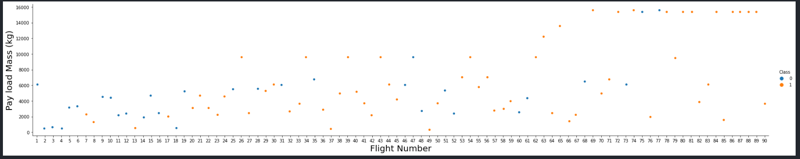
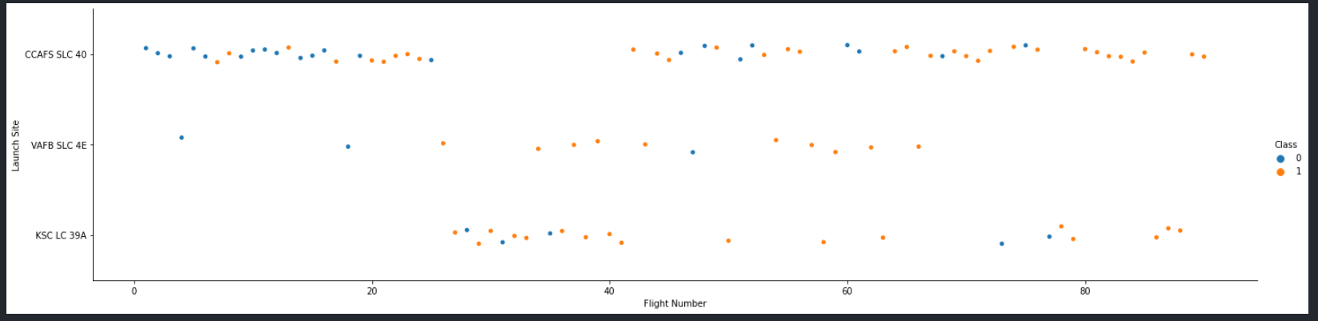
EDA with Data Visualization
To see relationship between Payload Mass and Flight Number, Launch Site and Flight Number, Launch Site and Payload Mass, Orbit and Flight Number, Payload and Orbit, we use scatter plot and bar plot
https://github.com/nguyenanhduc6479/data-science/blob/2fb96a22a7b006d66a6268e59c1c44a1e8840b9e/19.jupyter-labs-eda-dataviz.ipynb

Slide 12
EDA with SQL
Some SQL queries we performed:
• Names of the unique launch sites in the space mission;
• Top 5 launch sites whose name begin with the string 'CCA’;
• Total payload mass carried by boosters launched by NASA (CRS);
• Average payload mass carried by booster version F9 v1.1;
• Date when the first successful landing outcome in ground pad was achieved;
• Names of the boosters which have success in drone ship and have payload mass between 4000 and 6000 kg;
• Total number of successful and failure mission outcomes;
• Names of the booster versions which have carried the maximum payload mass;
• Failed landing outcomes in drone ship, their booster versions, and launch site names for in year 2015
• Rank of the count of landing outcomes (such as Failure (drone ship) or Success (ground pad)) between the date 2010-06-04 and 2017-03-20.
https://github.com/nguyenanhduc6479/data-science/blob/97526b9c0d63e861dd0650023f27ec37e1e533a1/18.jupyter-labs-eda-sql-coursera.ipynb

Slide 13
Build an Interactive Map with Folium
Markers indicate points like launch site
Circles indicate areas like NASA Johnson Space Center
Marker cluster indicate groups of events in each coordinate
Lines indicate distances between two coordinates
https://github.com/nguyenanhduc6479/data-science/blob/97526b9c0d63e861dd0650023f27ec37e1e533a1/20.lab_jupyter_launch_site_location.ipynb

Slide 14
Build a Dashboard with Plotly Dash
The following graphs and plots were used to visualize data
• Percentage of launches by site
• Payload range
These two plots help us analyze the relation between payload and launch site. These insights allow you to choose place to launch based on payload
https://github.com/nguyenanhduc6479/data-science/blob/852d2de9750d4e3f976d9b88a86a2fbaedb26c68/spacex_dash.py

Slide 15
Predictive Analysis (Classification)
Data preparation and standardization
Test of each model with combination of hyperparameters
Compare results
We build 4 classification models: logistic regression, support vector machine, decision tree, k nearest neighbors
https://github.com/nguyenanhduc6479/data-science/blob/92221f8ee82bbf6974882edfdfd8e53382830d0e/21.SpaceX_Machine%20Learning%20Prediction_Part_5.ipynb

Slide 16
Results
4 different launch sites
The average payload of F9 v1.1 booster is 2,928 kg
The first success landing outcome happened in 2015
Many Falcon 9 booster versions were successful at landing in drone ships
Almost 100% of mission outcomes were successful
The number of landing outcomes became as better as years passed
Predictive Analysis showed that Logistic Regression is the best model to predict successful landings, having accuracy over 84% and accuracy for test data over 83%.

Slide 17

Section 2

Slide 18
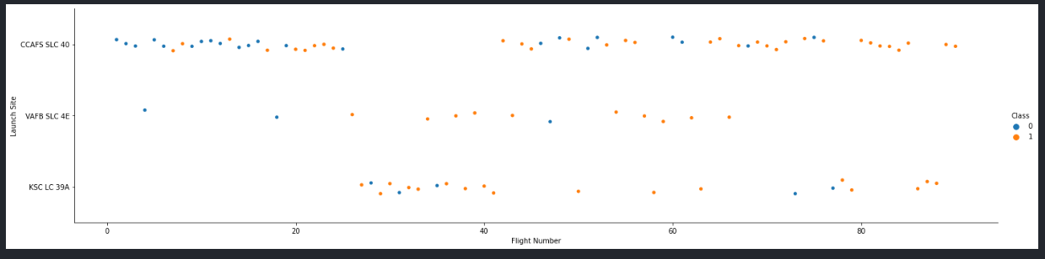
Flight Number vs. Launch Site
Launch Site CCAFS SLC 40 recently gives the best performance when most of the launches were successful
General success rate improve over time

Slide 19
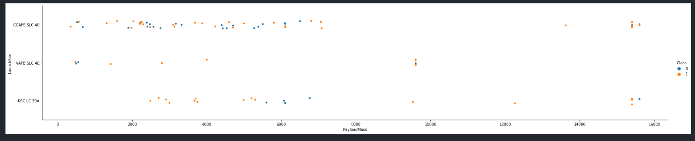
Payload vs. Launch Site
KSC LS 39A has very good success rate with every payload mass
Over 9000kg has good success rate
With payload over 12000kg we should choose CCAFS SLC 40 or KSC LC 39A because they had succeed with this mass several times

Slide 20
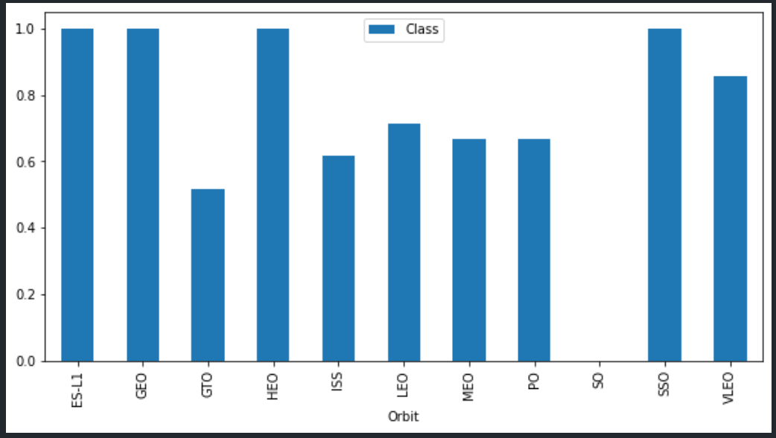
Success Rate vs. Orbit Type
ES-L1, GEO, HEO, SSO have the highest success rate

Slide 21
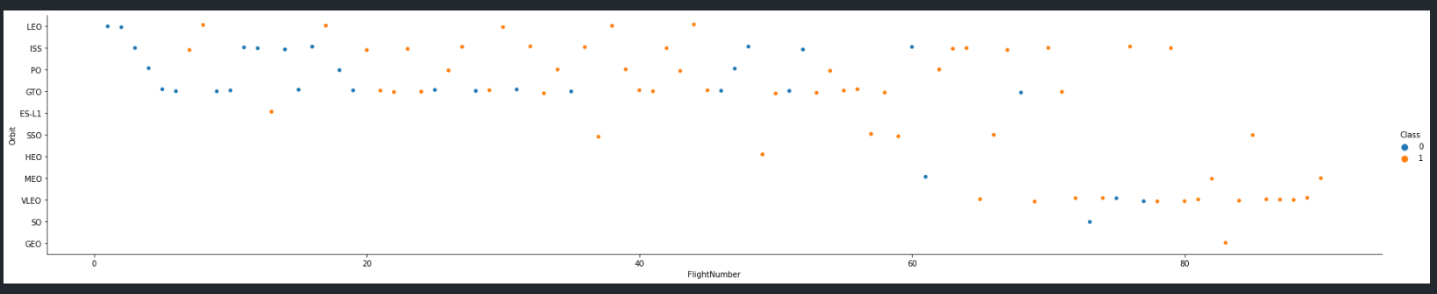
Flight Number vs. Orbit Type
Success rate improved over time
VLEO has been used recently and its performance was great

Slide 22
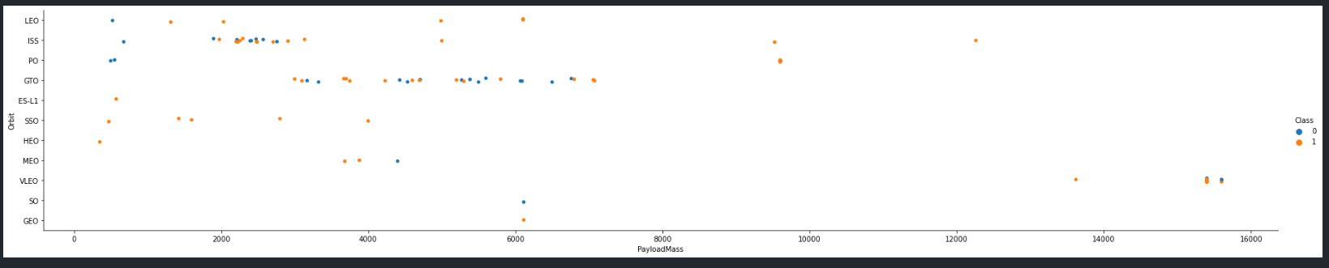
Payload vs. Orbit Type
ISS has the widest range of payload
With massive payload like over 14000kg they seemed to like using VLEO

Slide 23
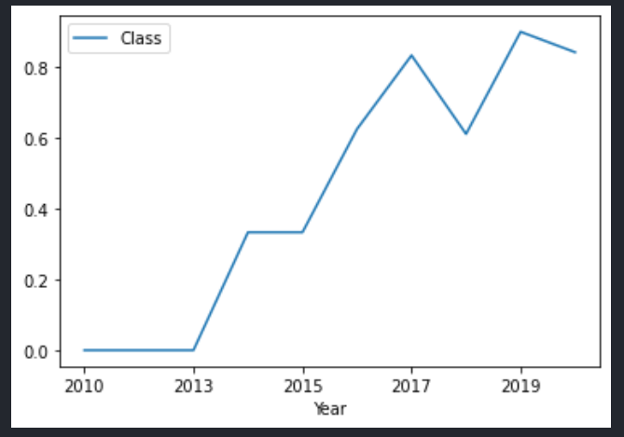
Launch Success Yearly Trend
Success rate keep improving since 2013
Highest success rate is in 2019

Slide 24
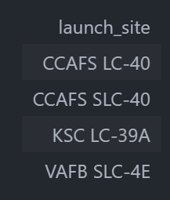
All Launch Site Names
Find unique launch site name in data frame

Slide 25
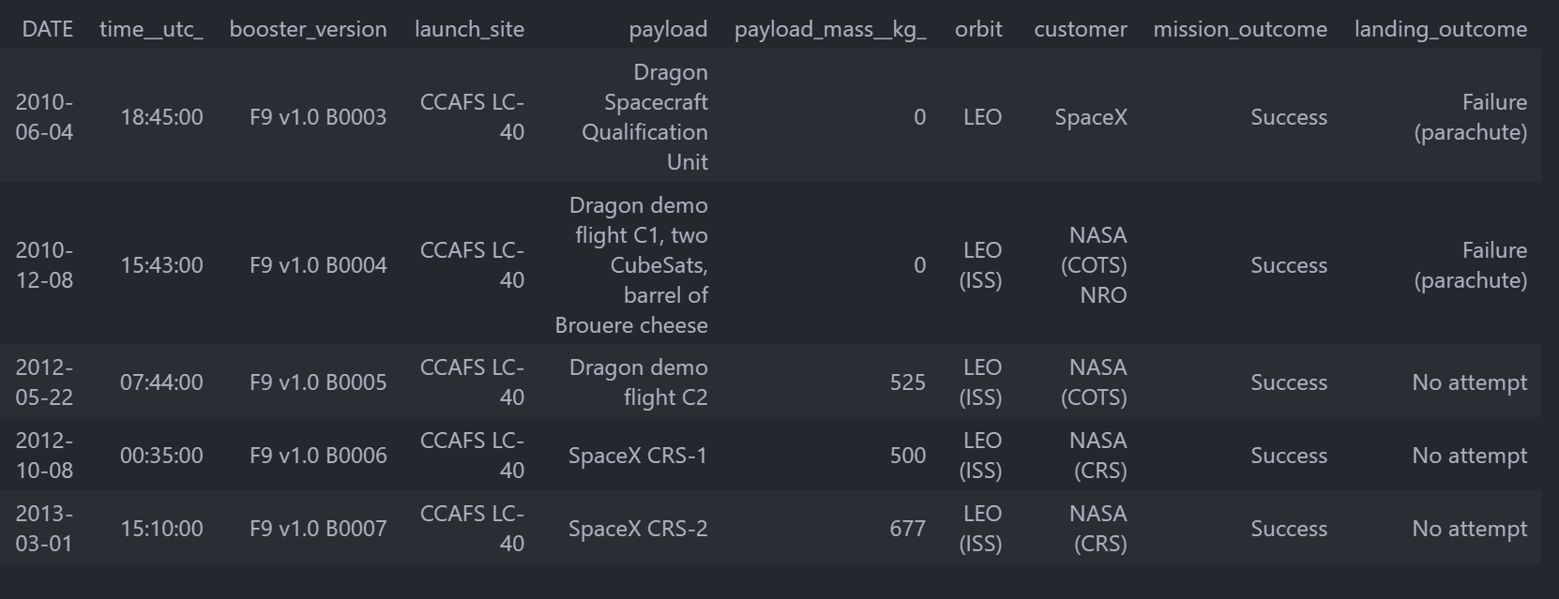
Launch Site Names Begin with 'CCA'
Show first 5 result which launch site begin with ‘CCA’

Slide 26
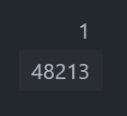
Total Payload Mass
Using SUM function with customers have ‘CRS’ in it

Slide 27
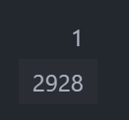
Average Payload Mass by F9 v1.1
Choose all F9 v1.1 booster version and then add all the payload mass together

Slide 28

First Successful Ground Landing Date
Filtering data by successful landing outcome on ground pad and getting the minimum value for date it’s possible to identify the first occurrence, that happened on 12/22/2015.

Slide 29
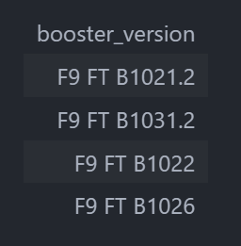
Successful Drone Ship Landing with Payload between 4000 and 6000
List the names of boosters which have successfully landed on drone ship and had payload mass greater than 4000 but less than 6000
Selecting distinct booster versions according to the filters above, these 4 are the result.

Slide 30
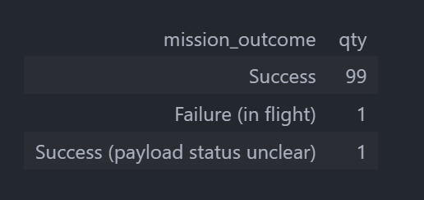
Total Number of Successful and Failure Mission Outcomes
Calculate the total number of successful and failure mission outcomes
Grouping mission outcome and count records help us to get quantities of each outcome

Slide 31
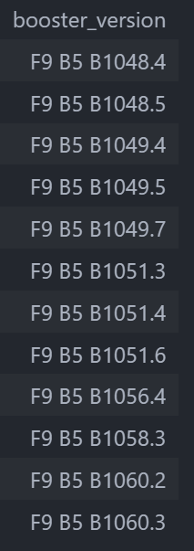
Boosters Carried Maximum Payload
List the names of the booster which have carried the maximum payload mass
Get the maximum payload and find the booster version with that payload

Slide 32
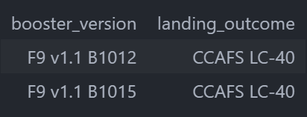
2015 Launch Records
Failed landing_outcomes in drone ship, their booster versions, and launch site names for in year 2015

Slide 33
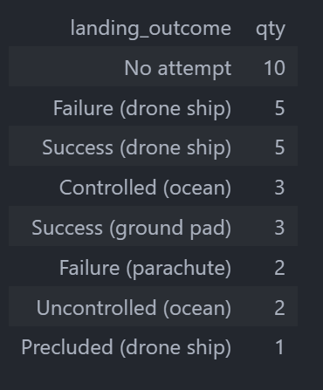
Rank Landing Outcomes Between 2010-06-04 and 2017-03-20
Rank the count of landing outcomes (such as Failure (drone ship) or Success (ground pad)) between the date 2010-06-04 and 2017-03-20, in descending order

Slide 34

Section 3

Slide 35
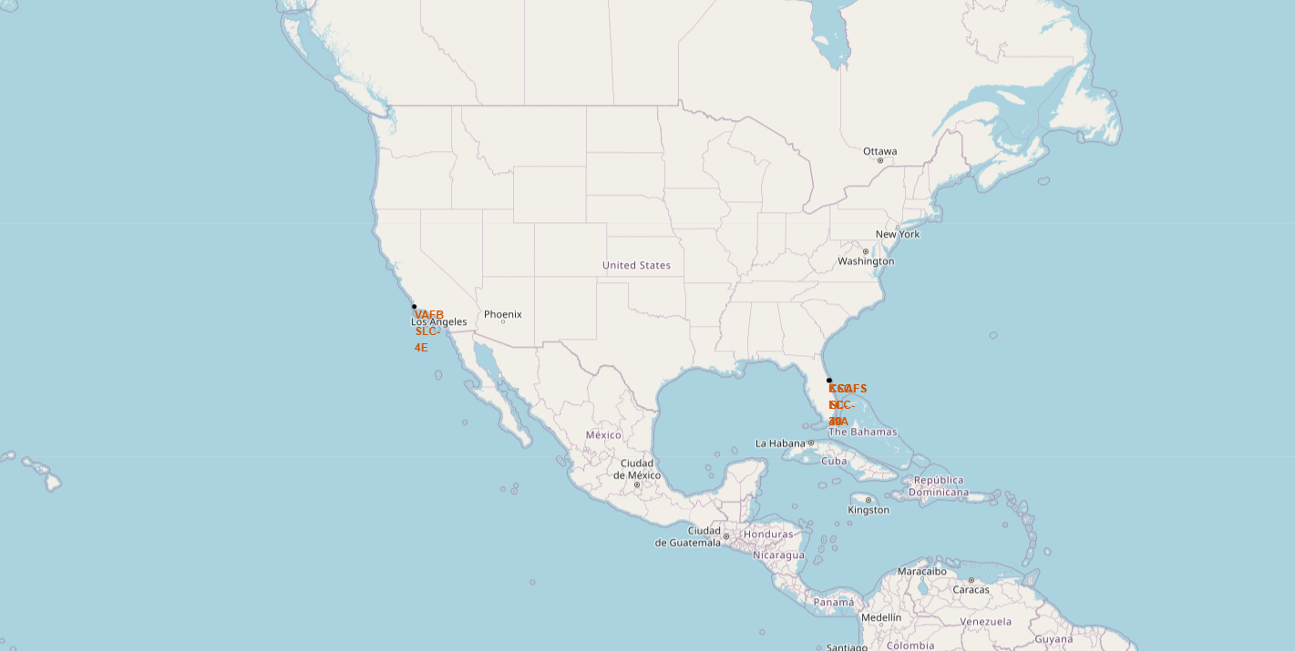
ALL LAUNCH SITES
Launch site located near sea, but not too far from roads and railroads

Slide 36
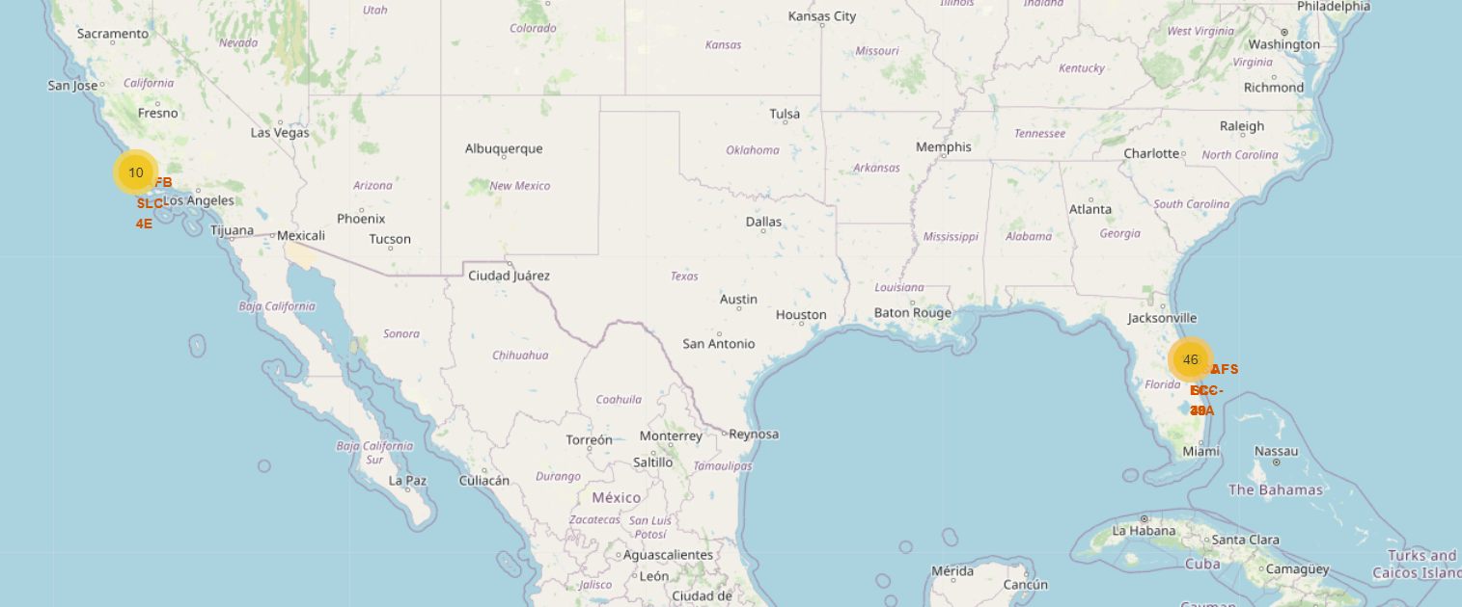
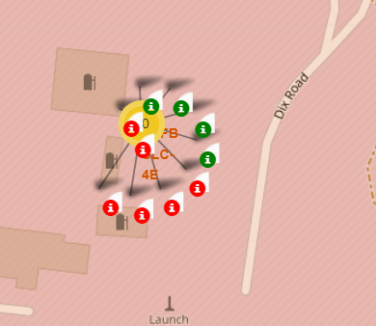
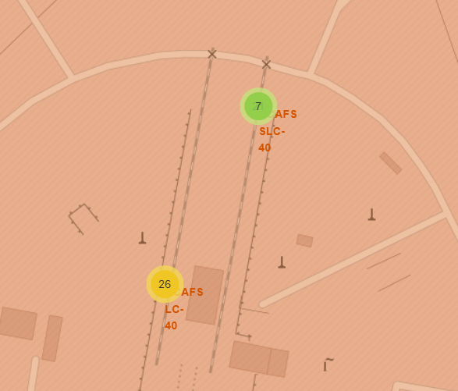
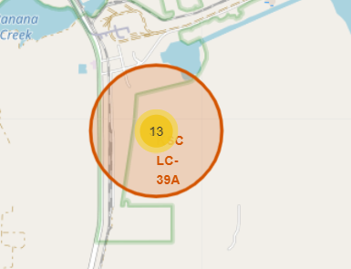
LAUNCH OUTCOME BY SITE
Green marker indicate success outcome
Red marker indicate failure outcome

Slide 37
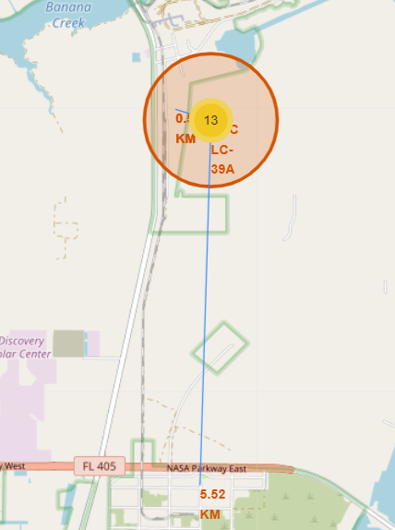
NEAREST LOCATION
Launch site KSC LC-39A has good logistics aspects, being near railroad and road and relatively far from inhabited areas.

Slide 38

Section 4

Slide 39
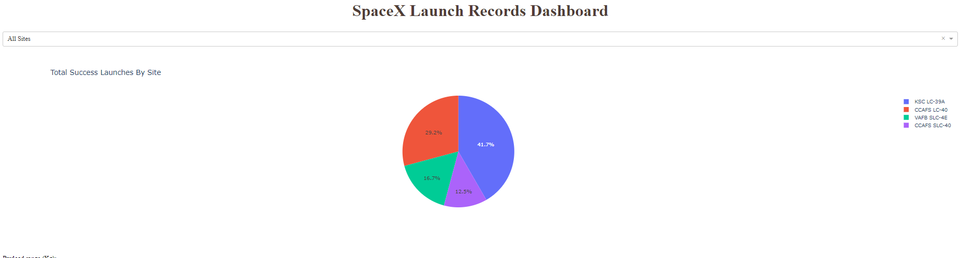
SUCCESSFUL LAUNCH BY SITE
KSC LC-39A has the most successful launch
Next to that is CCAFS LC-40
The other two launch site has similar number of successful launch

Slide 40
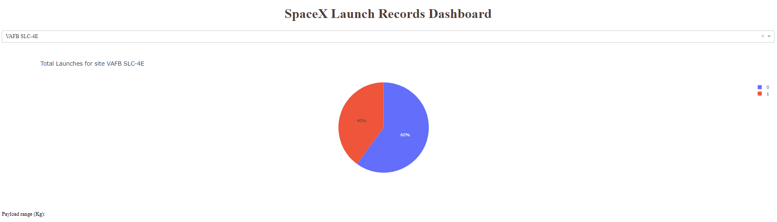
SUCCESS RATE FOR VAFB SLC-4E
This site has only 40% success rate

Slide 41
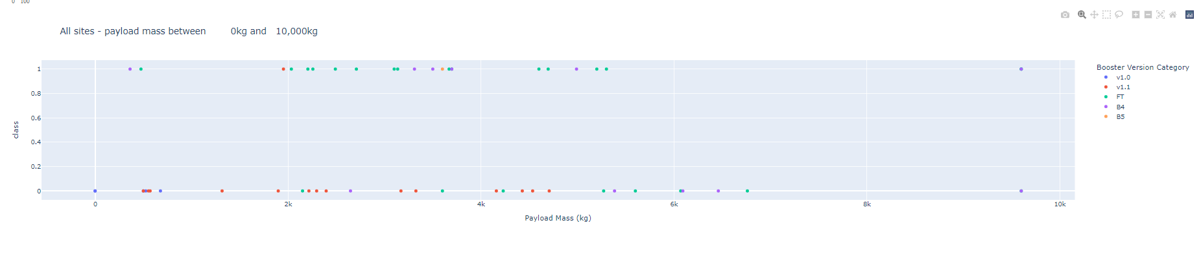
PAYLOAD VS OUTCOME
FT has the most successful outcome

Slide 42

Section 5

Slide 43
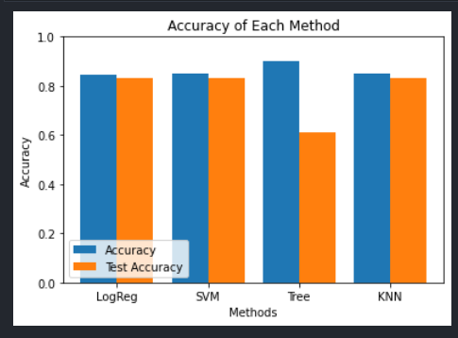
Classification Accuracy
The tree model has the highest accuracy on train data but also the lowest accuracy on test data

Slide 44
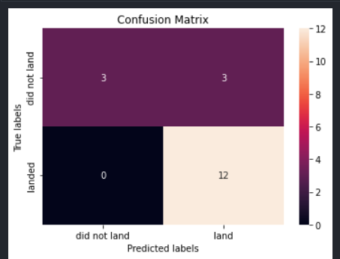
Confusion Matrix
Confusion matrix of Logistic Regression Classifier proves its accuracy by showing the big numbers of true positive and true negative compared to the false ones.
84% on train data and 83% on test data

Slide 45
Conclusions
The best launch site is KSC LC-39A
Success rate seem to be improved over time
Logistic Regression can be used to predict successful outcome
Payload about 7000kg seem to be ideal

Slide 46


